Slide 1

Open Source Air Quality Monitor Proposal
Adam Dezay, Manny Garcia, Brandon Hippe, and Mercedes Newton
Notes:
Adam

Slide 2

Executive Summary
Executive Summary
We aim to build a device to monitor elevated or dangerous qualities of pollutants such as PM 2.5 and CO₂ as well as measuring airspeed using as many open source components as possible. We aim to create 10 wireless, battery powered initial prototypes with at least 1 year of life span.
‹#›
Notes:
Adam

Slide 3
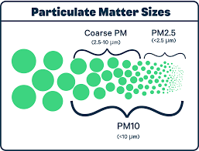


Background
Background
What we’re monitoring
CO₂ | Fine Particulate Matter (PM2.5) | Airflow
The WHO recommends an upper limit of 5 ug/m3 (microgram per cubic meter) average annually and 15 ug/m3 average over a 24 hour period[1] .
OSHA permits up to 5K PPM per 8 hour exposure with 400-600 being average CO₂ [2]
sources
[1]https://www.epa.gov/criteria-air-pollutants/naaqs-table
[2]https://www.fsis.usda.gov/sites/default/files/media_file/2020-08/Carbon-Dioxide.pdf
‹#›
Notes:
Adam

Slide 4
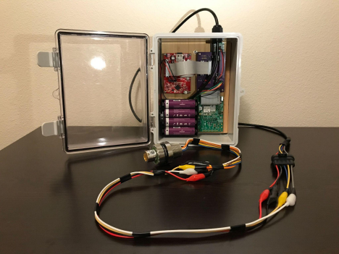
Background
Background
The System
Based on last year’s capstone project
Upgrade to OpenWSN wireless system
Measure CO₂ and PM2.5 instead of N₂O
Better Battery life
10 working nodes
‹#›
Notes:
Adam
The system will be based on components past capstone teams have successfully incorporated such as the TI MSP430 (including super low-power sleep modes).
In this iteration, we will aim to replace the closed-source proprietary SmartMesh IP wireless system with the OpenWSN open-source wireless networking system.

Slide 5
Section Title / Topic
Project Overview
Produce a wireless, within budget, and long life project
A particular goal of this project is very low power performance
Data should be temporarily logged locally and wirelessly communicated to base station(s) as appropriate.
A stretch goal includes a visualization dashboard to present the logged data graphically for at-a-glance use.
The device should be mechanically integrated into as small a form-factor as is practical and contained in a robust housing appropriate for indoor environments.
‹#›
Notes:
Adam

Slide 6
Section Title / Topic
Project Overview
Phase 1
Select, Implement, and assess performance of sensors
Particular focuses include power consumption, cost and accuracy
Phase 2
Make it Wireless
Incorporate into system that wakes up, takes measurement , transmit wirelessly, then go back to sleep
‹#›
Notes:
Mercedes

Slide 7
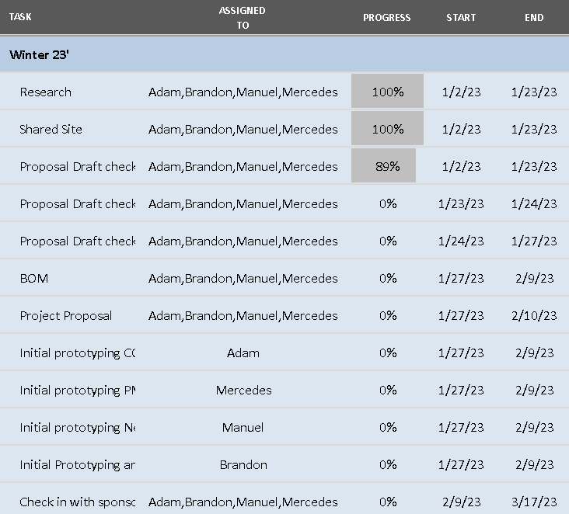
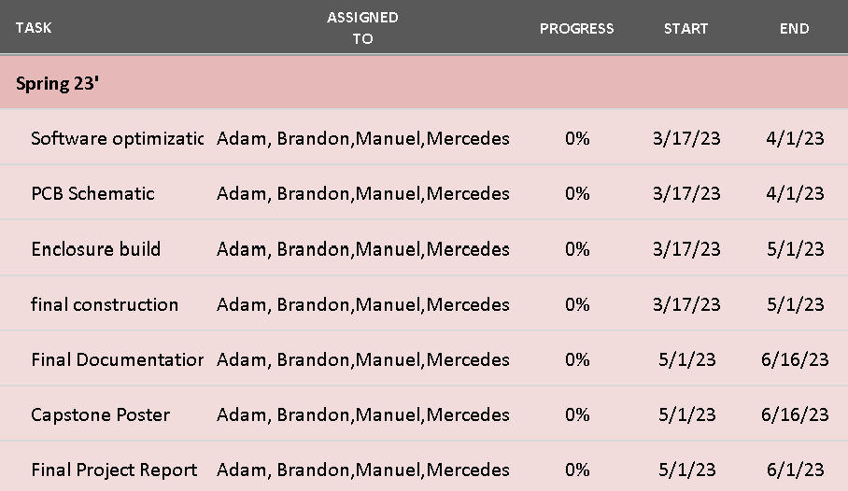
Section Title / Topic
Timeline
Winter and Spring Term Project Timelines
‹#›
Notes:
Mercedes

Slide 8
Section Title / Topic
Product Design Specification
Stakeholders
Industry Sponsor : Dr. David Burnett (Principle Investigator of WEST Lab at Portland State University)
Faculty Advisor: Dr. John Acken
Engineers:
Adam Dezay
Manuel Garcia
Brandon Hippe
Mercedes Newton
Customer: Any business in need of monitoring changing air quality conditions and their employees.
‹#›
Notes:
Mercedes

Slide 9
Section Title / Topic
Requirements
Must
Sense PM2.5, CO₂
Maximize its battery life for sustained operation
Locally store its measurement data
Use as many open-source components as possible
Should
Sense airspeed and direction
Have a battery life of at least 1 year
Wirelessly share its measurement data with other sensor systems and central monitoring system
Be entirely open-source
Must have an enclosure
May
Monitor other environmental conditions
Be usable outdoors
Include a visualization dashboard to monitor the data graphically
‹#›
Notes:
Mercedes

Slide 10
Section Title / Topic
Specifications
The sensor system must:
Have 3 iterations that cost no more than $1,000 total
The sensor system should:
Have 10 iterations that cost no more than $3,000 total
Utilize 18560 lithium ion battery cell/s
Utilize Texas Instruments MSP430/432 class microcontroller unit
Utilize Smart mesh
Utilize Wireless Sensor Network (WSN)
The sensor may:
Be able to incorporate many more (>10) sensor modules
Match lifetime of a fire detector (~10 years)
‹#›
Notes:
Mercedes

Slide 11
Section Title / Topic
Deliverables
Complete documentation
Project proposal
Weekly Progress Reports
Final report
ECE Capstone Poster Session poster
Summary project report in the style of an academic paper
Bill of materials
System schematic & functional diagram
Design files for any custom mechanical components or PCBs
Source code
Operation guide
Demonstration hardware
10 sensor system prototypes
‹#›
Notes:
Brandon

Slide 12
Section Title / Topic
Initial Product Design
Our design takes inspiration from smoke detectors. The goal is that each sensor node will be a small, self-contained unit that can be placed somewhere, set up, and then essentially forgotten. We will design a custom PCB to handle connections between the MCU, sensors, and battery components inside of the node, and all the components will be housed in a custom designed 3d printable enclosure.
The hardware components will include:
Texas Instruments MSP430/432 class microcontroller unit (MCU)
2.5 μm fine particulate matter (PM 2.5) sensor
CO₂ sensor (or equivalent CO₂ sensor)
Optional anemometer
Smartmesh networking
Custom PCB
18650 Lithium Ion Battery Cell(s)
Code for the nodes will be developed using Energia IDE/Code Composer Studio. For the host system, we plan to base our code on the work of the 2022 Capstone team, who developed their host software in Python.
‹#›
Notes:
Brandon

Slide 13
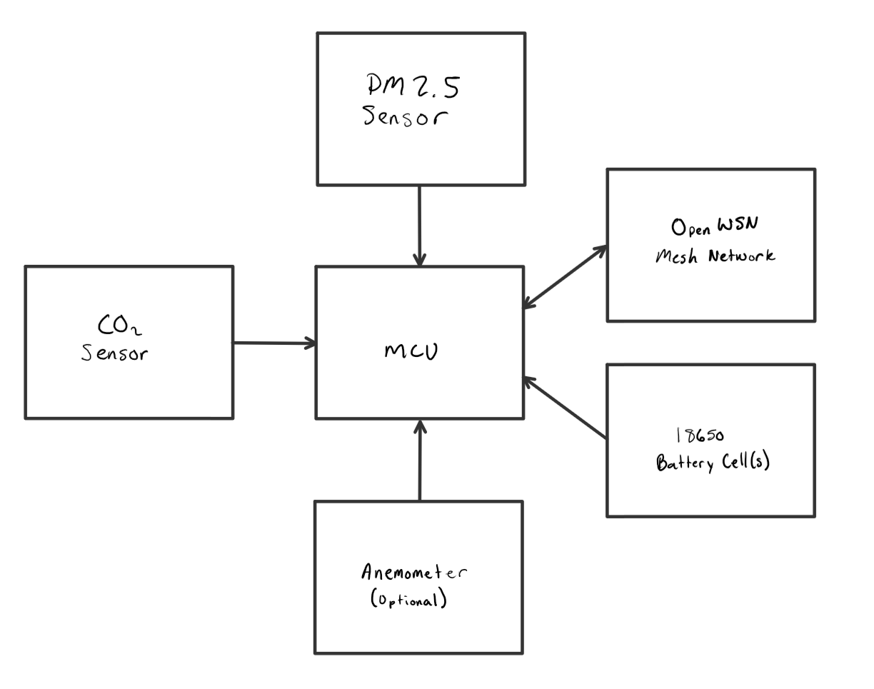
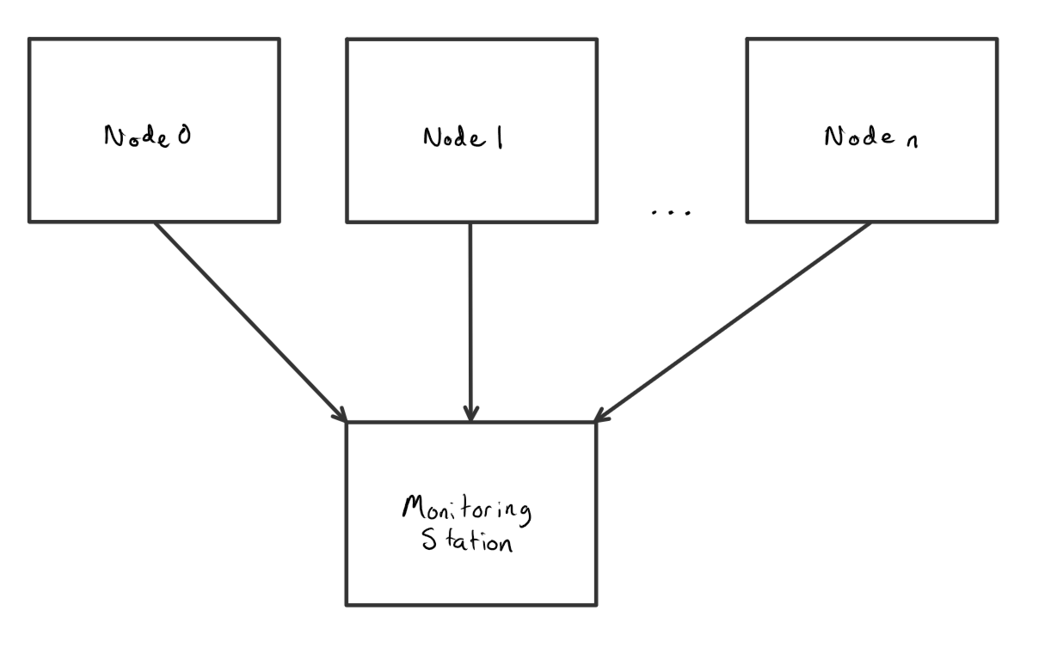
Section Title / Topic
L1 Diagram
Node Diagram and Mesh Network Diagram
‹#›
Notes:
Brandon

Slide 14
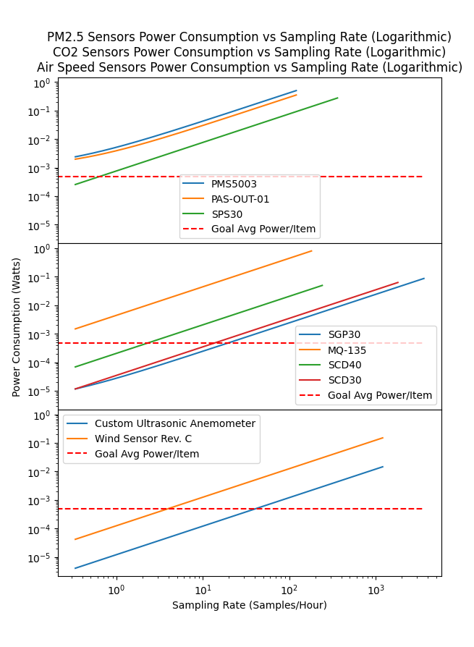
Section Title / Topic
Sensor Choices
Sensor Power Consumption vs Sampling Rate
We have conducted initial research for each of the different sensors to be incorporated into this device. Taking into consideration active and sleep mode power consumption, the graphs to the right show average power consumption vs sampling rate for each of the sensors under consideration. The red line represents the average power consumption of each sensor necessary to achieve 1 year battery life on a single 18650 cell. Only the sensors that reach this benchmark will be considered for this project.
‹#›
Notes:
Brandon

Slide 15
Section Title / Topic
Sensor Choices (CO₂)
 | SGP 30 | SCD 30
Type | E CO2 | CO2
Additional sensors | VOC | Temp Humidity
Range | 400-60k PPM | 0-40k PPM
Accuracy | ±15% | ±30PPM +3%
Power Consumption (On) | ~86 mW | ~63 mW
Price ($) | 17.50 | 58.95
Relative Size | Size of quarter | Double size
Notes | Can be more accurate with Humidity sensor Uses H2 to get CO2 | 2-1800s sampling range
Average outdoor PPM is 414 PPM
Cities have PPM between 600-900
OSHA permits up to 5K PPM per 8 hour exposure
40K PPM is where it gets to the deadly range
ANSI recommends below 700 PPM outdoor and 1200 PPM Indoor
Sources:
USDA
SGP30 Overview/datasheet/tutorial...etc
SCD 30 Overview/datasheet/tutorial...etc
‹#›
Notes:
Adam

Slide 16
Section Title / Topic
Sensor Choices (PM2.5)
 | PMS5003 | PAS-OUT-01 | PAS-IN-01 | SPS30
Range (concentration) | 0-500 ug/m³ | 0-31000 ug/m³ | 0-1500 ug/m³ | 0-1000 ug/m³
Accuracy | ±10% or ±10 ug/m³, whichever is greater | ±10% or ±10 ug/m³, whichever is greater | ±1ug/m³, | ±10% or ±10 ug/m³, whichever is greater
Power Consumption (On) | ~500 mW | ~350 mW | ~350mW | ~275 mW
Price ($) | 39.95 | Request Quote, student discount | Request Quote, student discount | 49.53
Notes | 30 seconds before accurate data, needs calibration every 30 days | 30 seconds before accurate data | 15 seconds before accurate data, | 10 seconds before accurate data
‹#›
Notes:
Mercedes

Slide 17
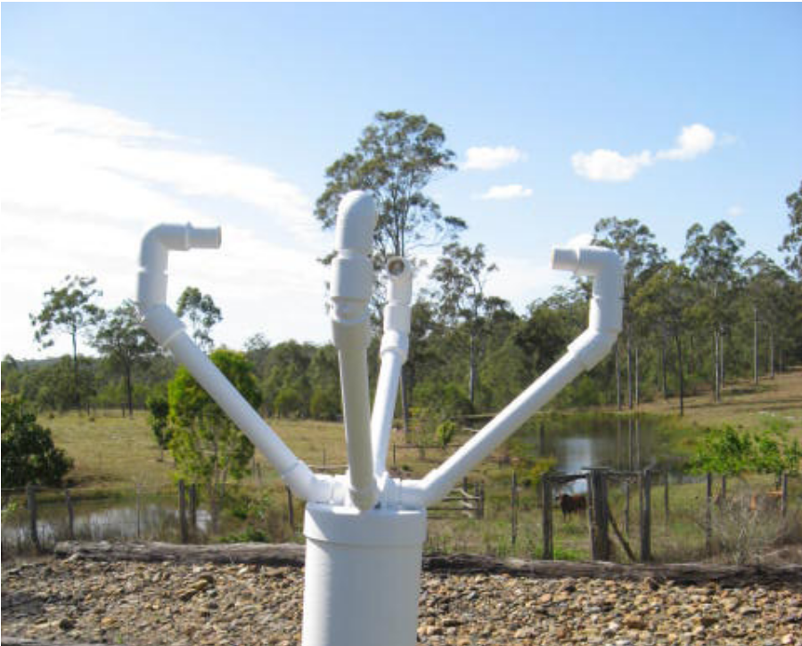
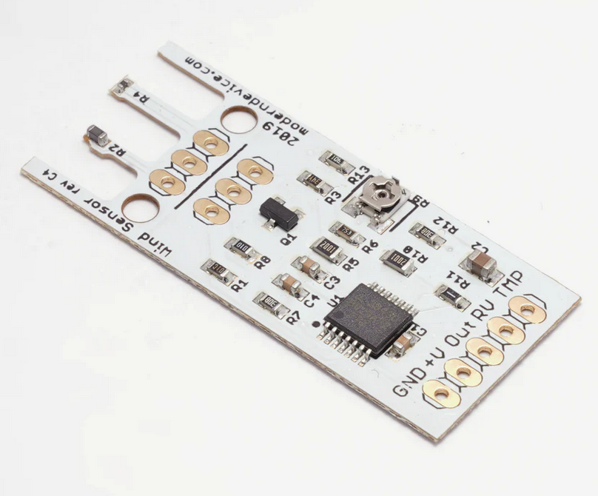
Section Title / Topic
Sensor Choices (Airflow)
 | Custom Ultrasonic Anemometer | Wind Sensor Rev. C
Type | Ultrasonic | Hotwire
Range | Unknown and depends on size (will build and test) | 0-60 MPH
Accuracy | Unknown and depends on size (will build and test) | Can detect “small puff of air at a distance of 18-24 inches”
Power Consumption (On) | ~14.52 mW | ~150 mW
Price ($) | 7.90 | 21.95
Relative Size | ~25-36 cm apart | .68″ × 1.590″ × .25″
Notes | Requires custom design | 10 second warm-up time
‹#›
Notes:
Brandon

Slide 18
Section Title / Topic
Budget and Resources
To start, the budget for this project will be $1000 with the goal of building 3-4 prototype nodes. From there, we’re estimating a cost of $300 per node, with a goal of building 10 nodes for $3000.
We will be utilizing several spaces on the Portland State University campus including but not limited to: the EPL (Electronics Prototyping Lab) for 3D printing and project assembly, Dr Burnett's research lab for meetings and project assembly, locker space in the Engineering building for project storage, and the third floor lobby of the Fariborz Maseeh Hall building for in person planning/documentation meetings. We will also utilize Zoom for meetings with our industry sponsor and our faculty advisor. For communication platforms, we will be using email to communicate with Dr Burnett and Dr Acken, and group communication will be completed via text messages, Discord, and Trello to ensure completion of projects. We will also use Github as our version control system, with a group Google Drive to share other miscellaneous items.
‹#›
Notes:
man

Slide 19
Section Title / Topic
Verification plans
To test our project, we’re planning to run a 24-hour test run on our initial batch of 3-4 nodes, and then again later on our final batch. During these tests, we hope to see the data being collected, logged, and transmitted correctly. We also will be monitoring the power consumption of each node using EnergyTrace. Testing for 24 hours should give us a good sanity check that our design should be able to run continuously for long periods of time, both from a maintenance and battery life standpoint. This test is planned to take place in the WEST Lab in FAB 60-24.
‹#›
Notes:
man

Slide 20
Section Title / Topic
Intellectual Property
This sensor system is intended to be open source. The design, including code, schematics, guides, and other necessary design files, will be protected under the GNU General Public License v3.0, and will be freely available on the project’s github repository.
The only intellectual property that we may end up using is the smartmesh wireless protocol, as well as their respective development boards. We do however plan on alleviating this issue by switching to OpenWSN which will make our whole project open source.
‹#›
Notes:
man

Slide 21
Section Title / Topic
Team & Development Process
Team Members and Skills/Project Interests:
Adam Dezay: Documentation, Github, Wiki, Soldering, Gantt Chart.
Manuel Garcia: KiCad Schematic & Board Layout, Programming, Web Development, General Hardware/Software Hacking, FreeCad
Brandon Hippe: Coding, Sensor implementation, wireless networking implementation, 3D printing, GUI development in Python and MATLAB, point of contact with sponsor
Mercedes Newton: Team captain, Weekly report leader, 3D printing, documentation, soldering, hardware implementation, power calculations, private consulting.
We will be utilizing collaboration tools such as Trello, Github, Google Drive and Zoom. Our point person for communicating with our industry sponsor and advisor is Brandon Hippe, and our team leader is Mercedes Newton.
‹#›
Notes:
manuel

Slide 22
Section Title / Topic
Questions we have
We are currently working on gathering more information in order to more concretely define some of the unknowns in our project. As of now our questions that we have are:
Which programming environment will be the most user friendly and reproducible
Specific sensors to use to enable long battery life & accurate sensing
Enclosure design to enable accurate readings, as well as protection
‹#›
Notes:
man

